Slide 1
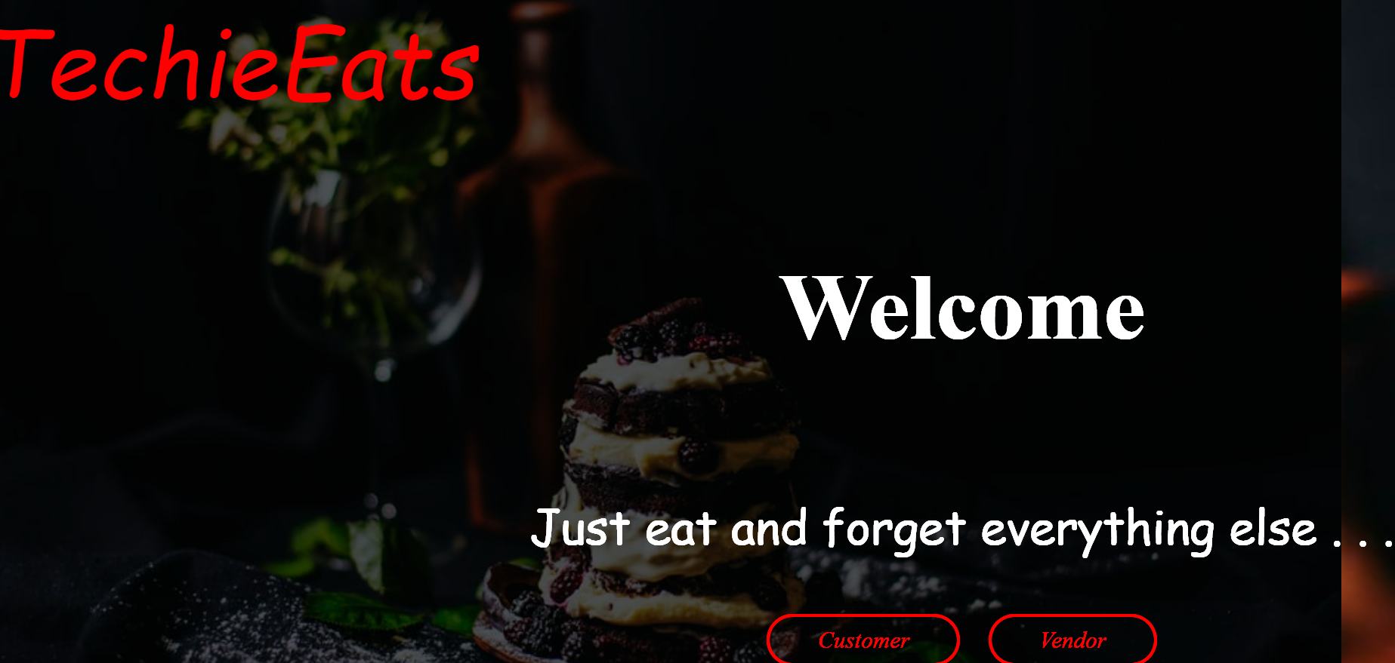

Slide 2
Introduction
Food delivery application in java web application project this is an online food delivery system for customesr and foodies
The main functionality of this application is to search your fav hotel and order your fav food from your place
The applications like zomoto,kfc,Domnisos

Slide 3

Food delivery application

Slide 4
Technologies Used
.
Data base
springboot
Java 8
nodejs
SQL Plus
Angular

Slide 5
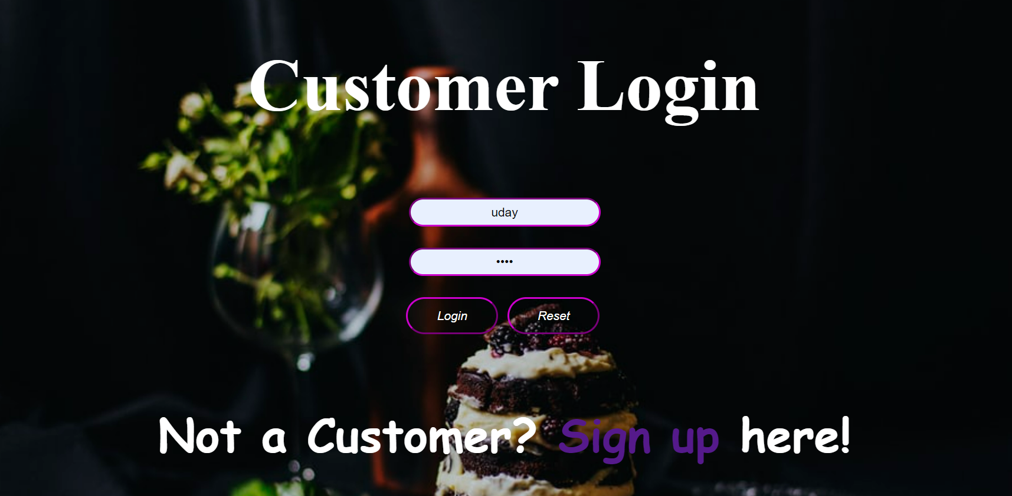

Slide 6
We can login though this customer login to get into the application After login we can save the password in google to keep you sign in to the application
Customer Login

Slide 7
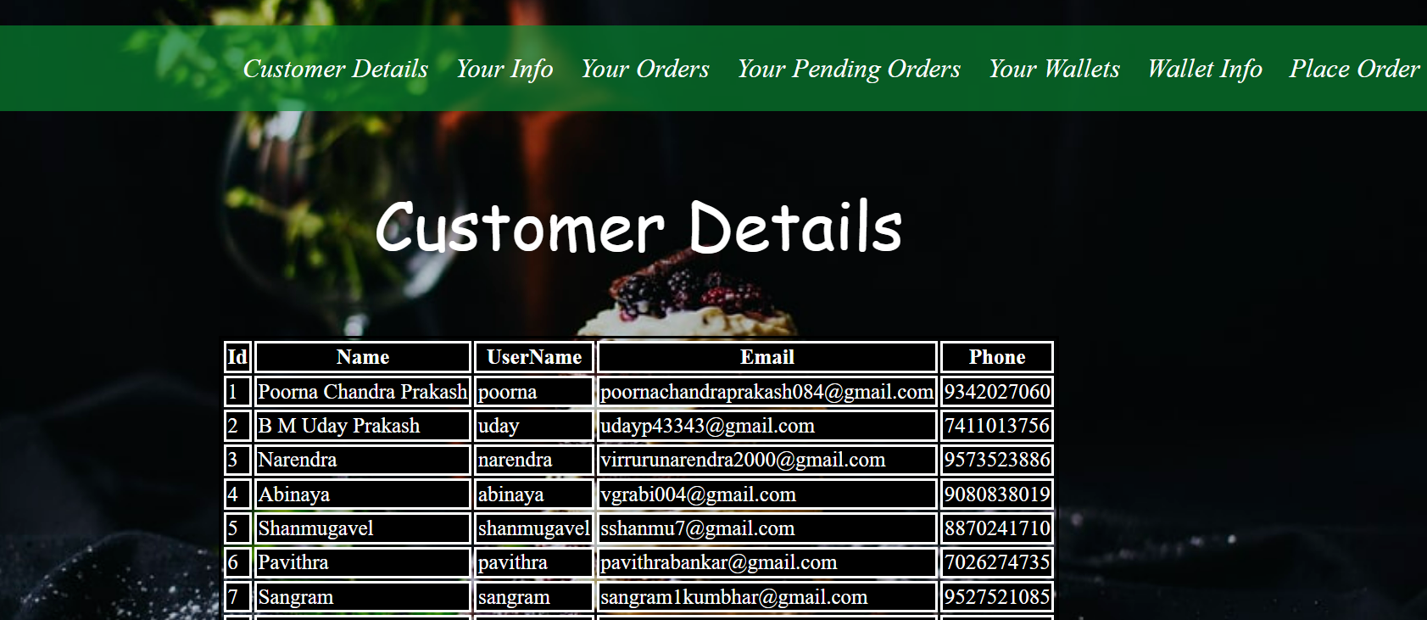

Slide 8
Customer Details
In customer details we have
Name: poorna Chandra
User id: poorna
Email address: poorna Chandra084@gmail.com
Phone:9342027060

Slide 9


Slide 10
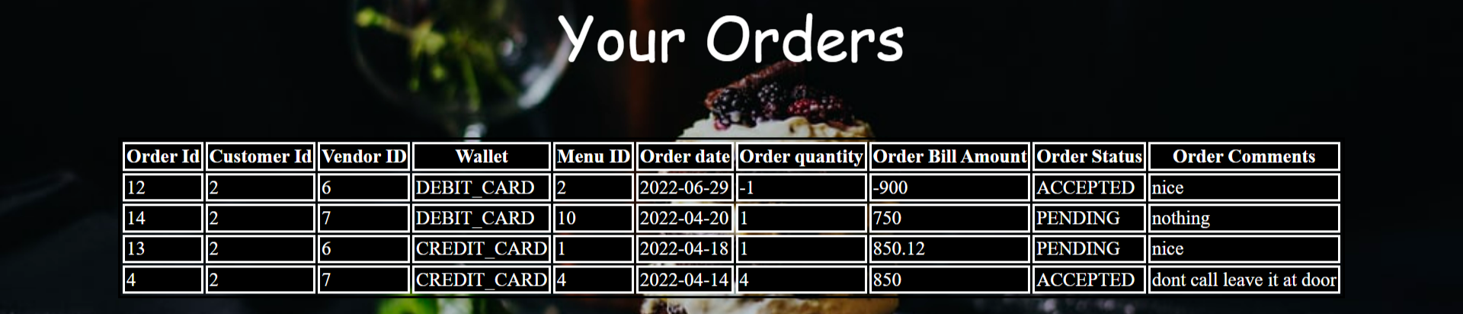

Slide 11
Your Order
In your you can see order status
You can see your customer id
You can see your vendor id
You can see your menu , ordrer date ,order quantity, ordered bill amount, oredere status

Slide 12


Slide 13
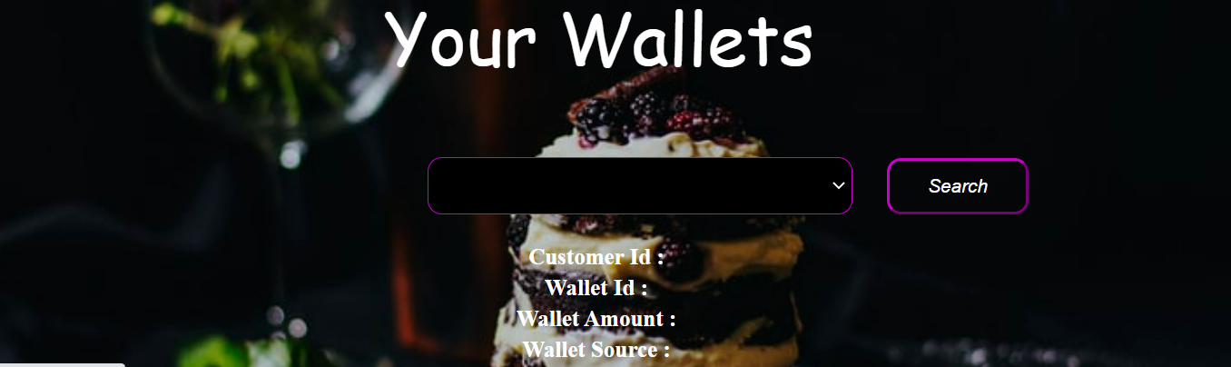

Slide 14
Your wallet
In your you can see your credit card ,and debit card balance

Slide 15
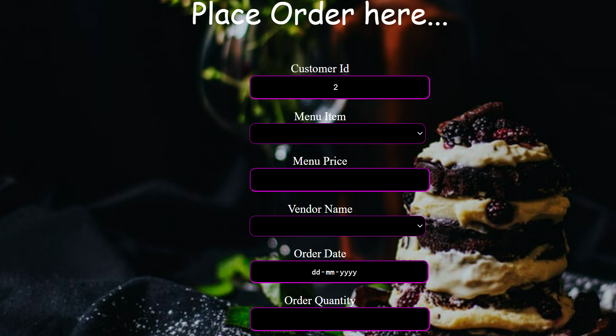

Slide 16
Place your Order
Here you can order your food
You can order your food in kfc,zomoto

Slide 17
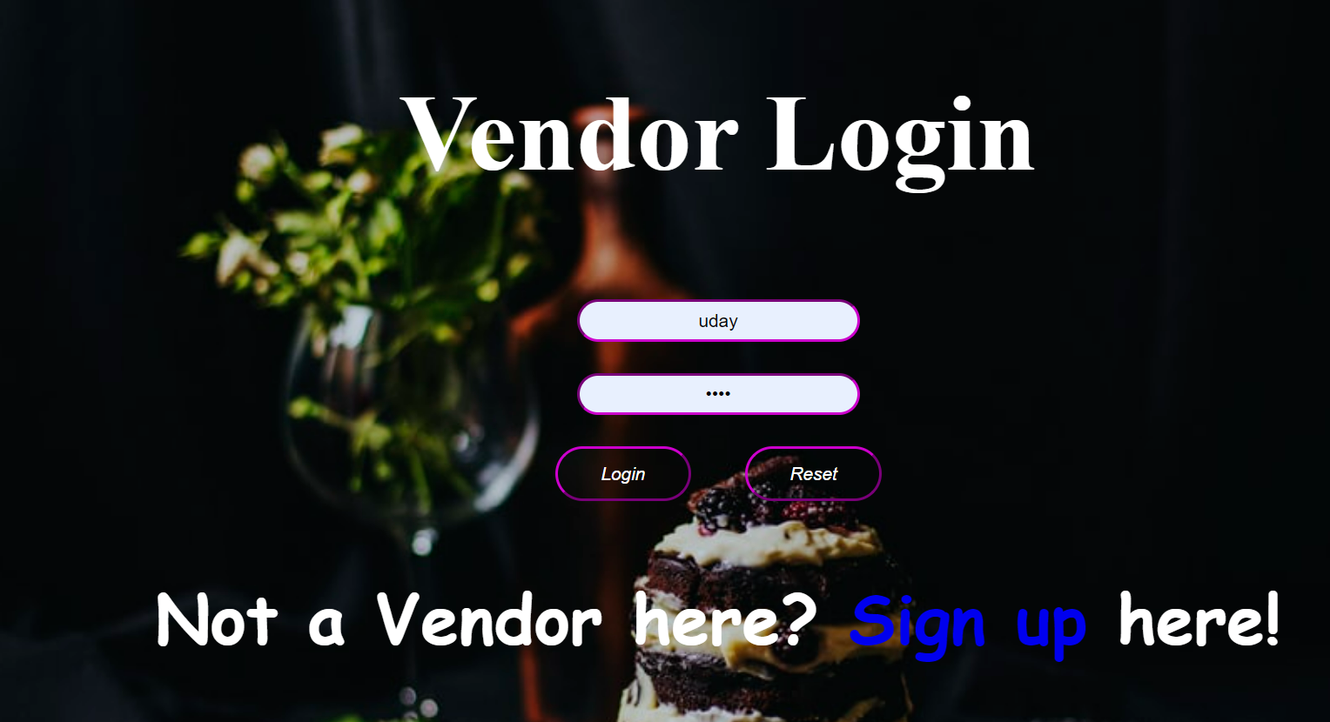

Slide 18
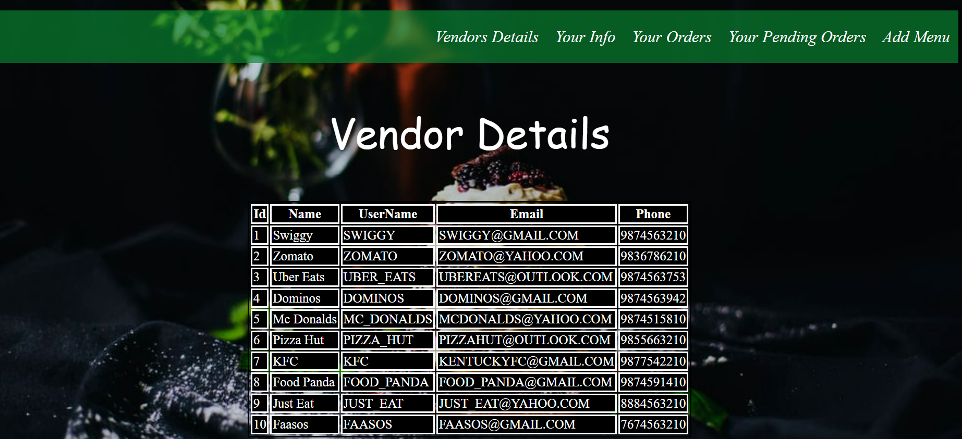

Slide 19
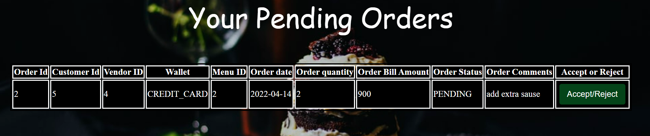

Slide 20
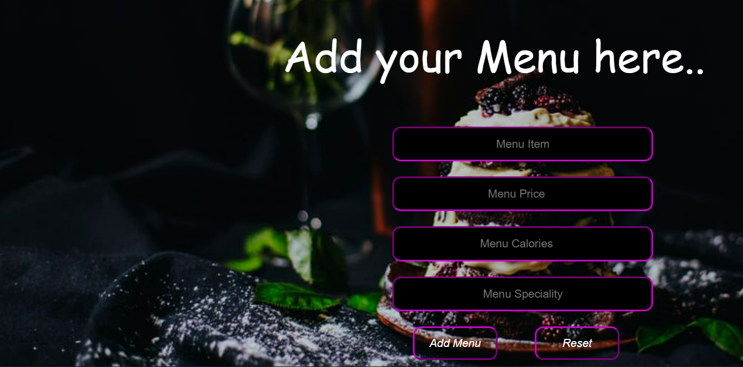

Slide 21
Add your Menu
Here you can see your menu items
Price of the food
Menu specility and Menu calories

Slide 22
Git hub link
https://github.com/santhosh110/food-delivery/

Slide 23
Thank You

